Slide 1
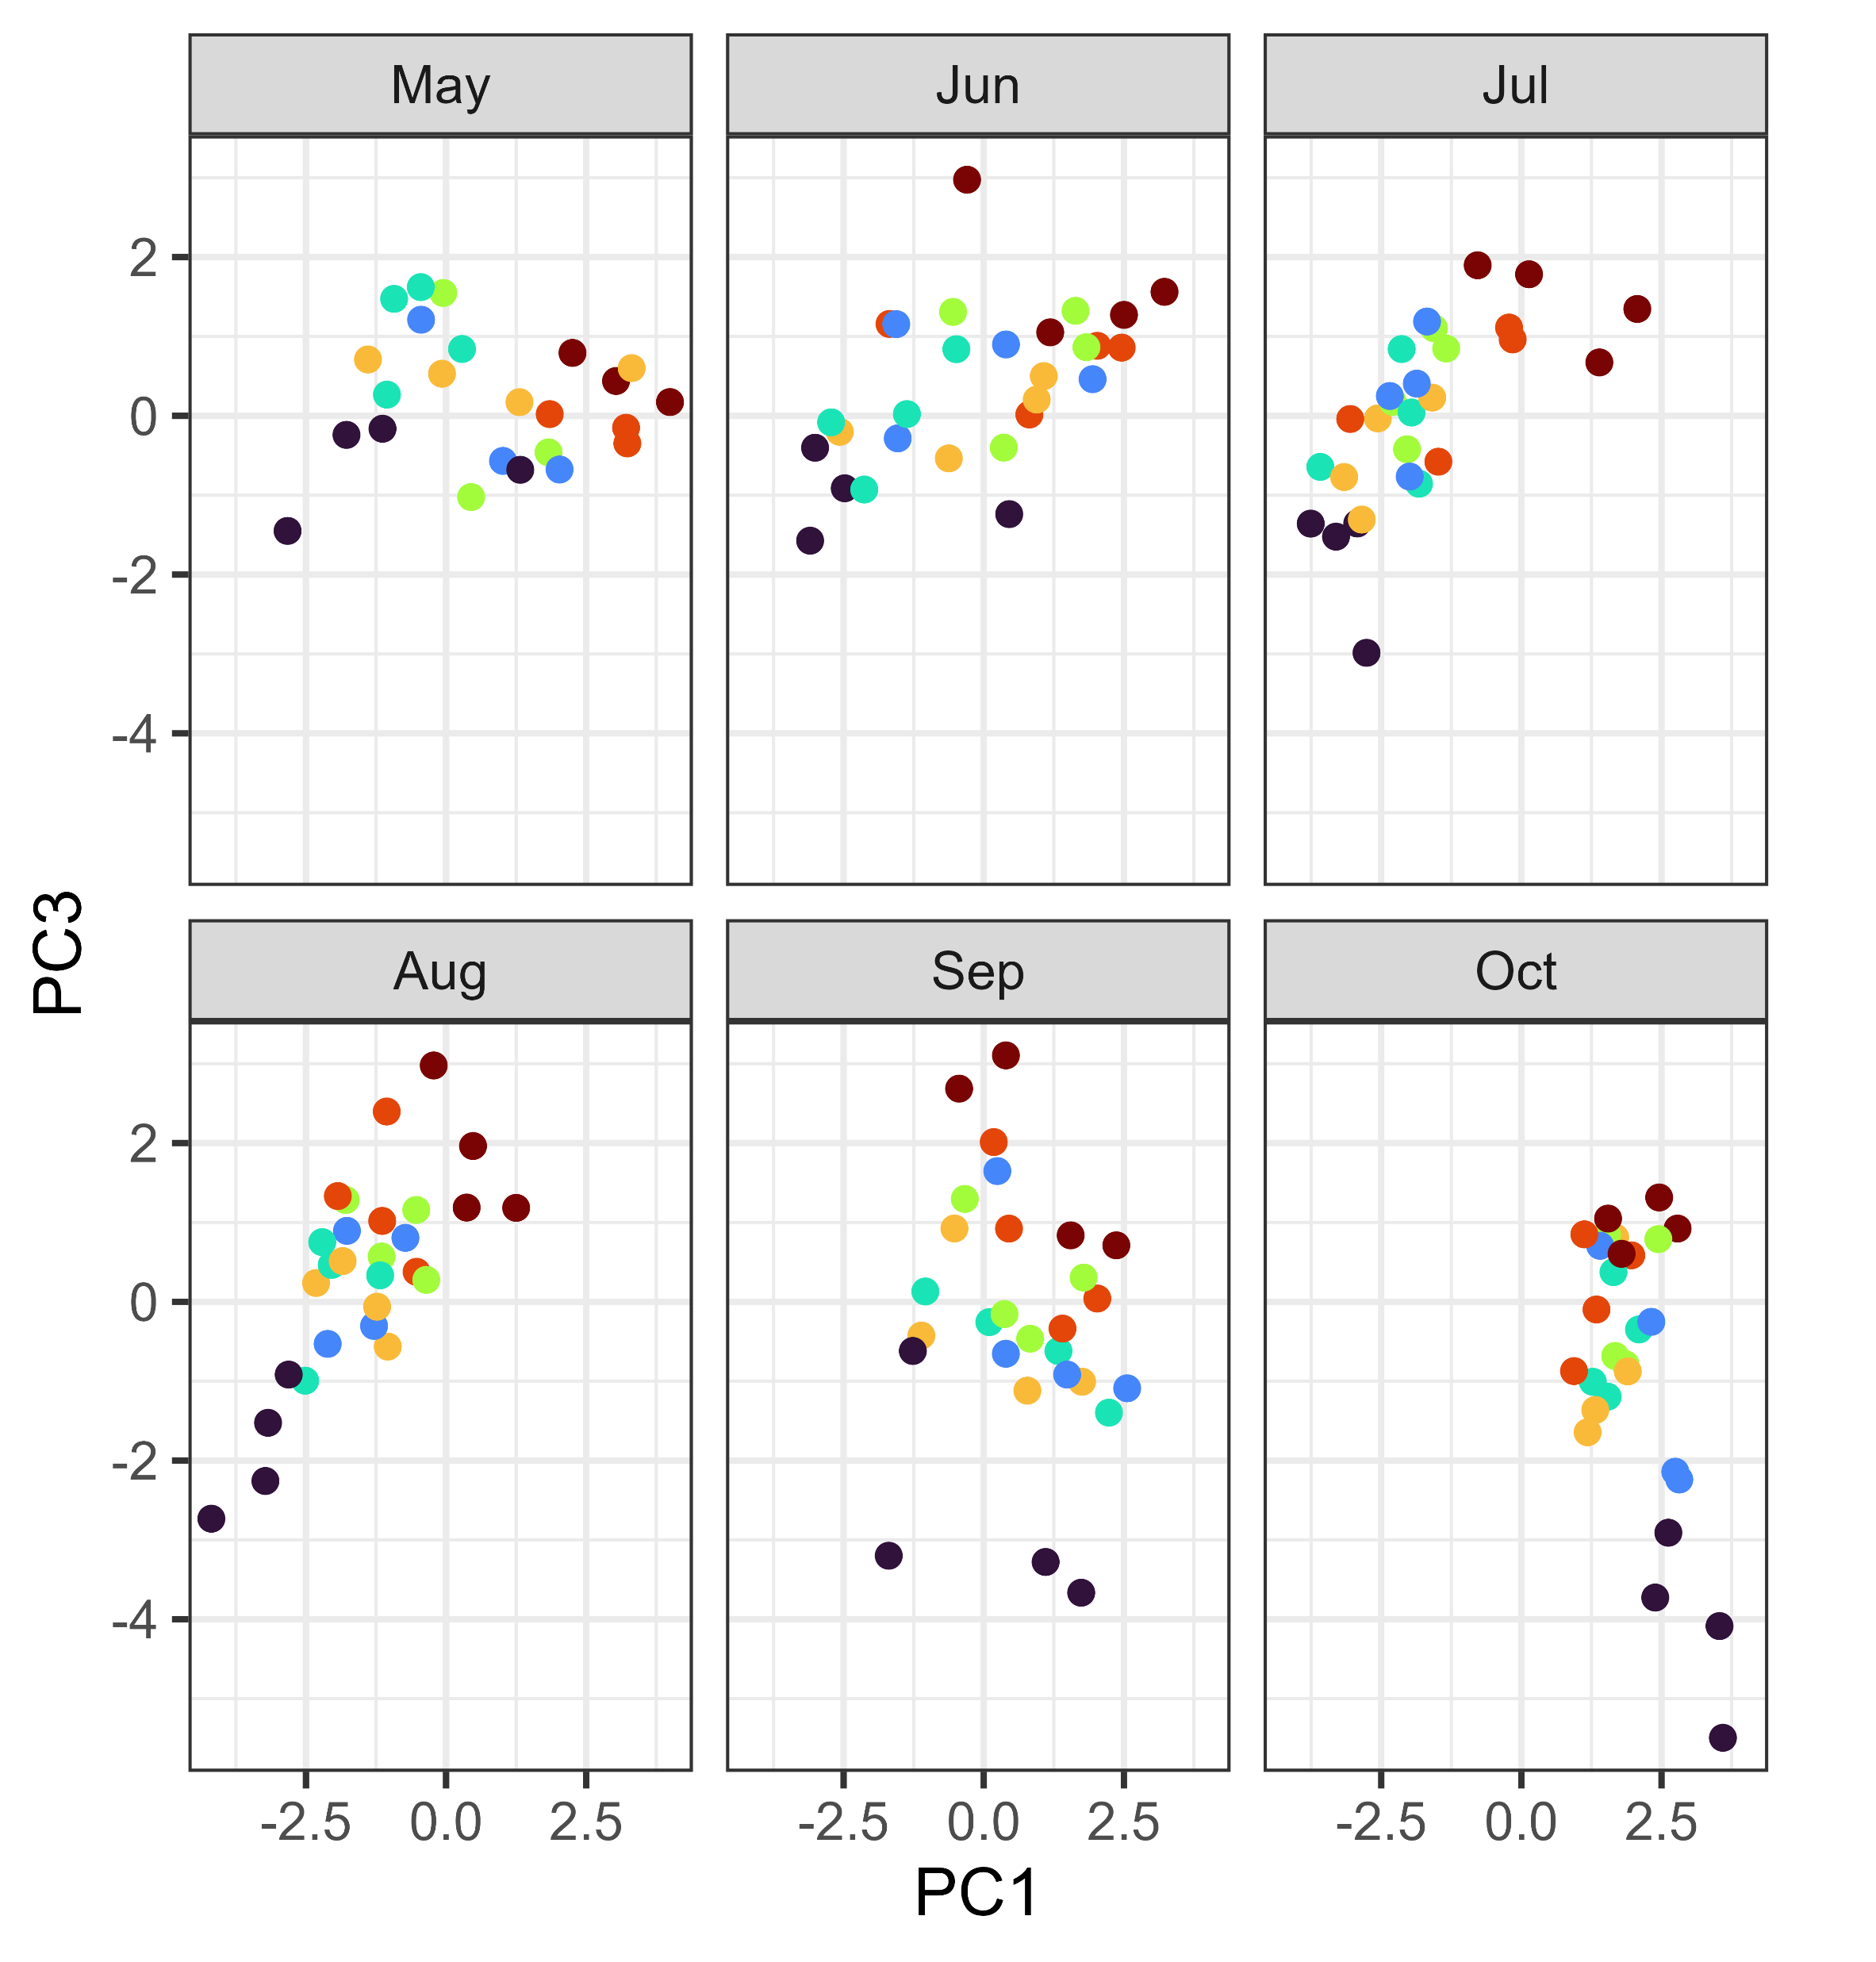
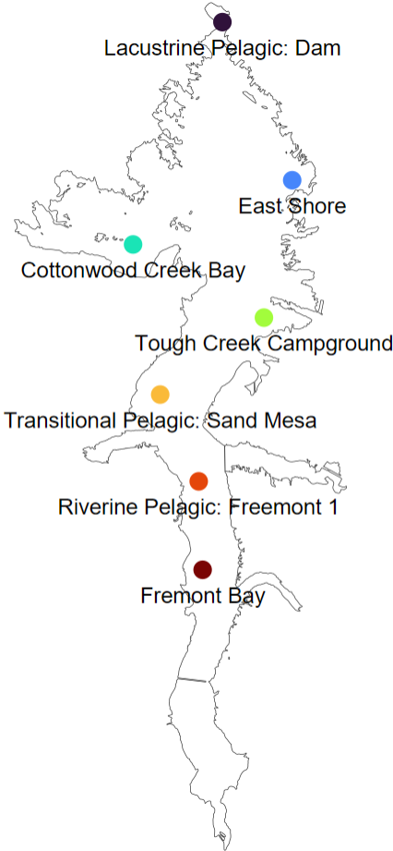
+
+
+
Inorganic N
Secchi depth
Maximum depth
-
-
-
-
-
+
+
+
+
Phosphate
TP
TN:TP
Inorganic N:phosphate
Temperature
Schmidt’s Stability
+
+
-
-
-
-

